Slide 1
Motor Areas of Cortex and Types of UMNs

Slide 2
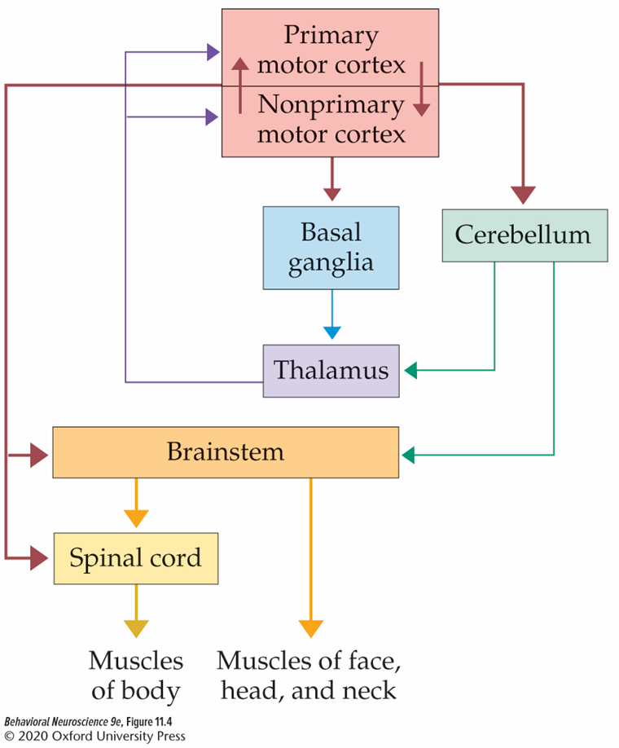
Hierarchical control of Motor movements
Primary and nonprimary motor cortices initiate commands for movement (top of hierarchy).
Cerebellum and basal ganglia can modulate activities of these control systems via the thalamus in a loop back to cortex.
Brainstem integrates motor commands and relays sensory information

Slide 3
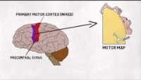
2 minute neuroscience: Motor areas of Cortex

Slide 4
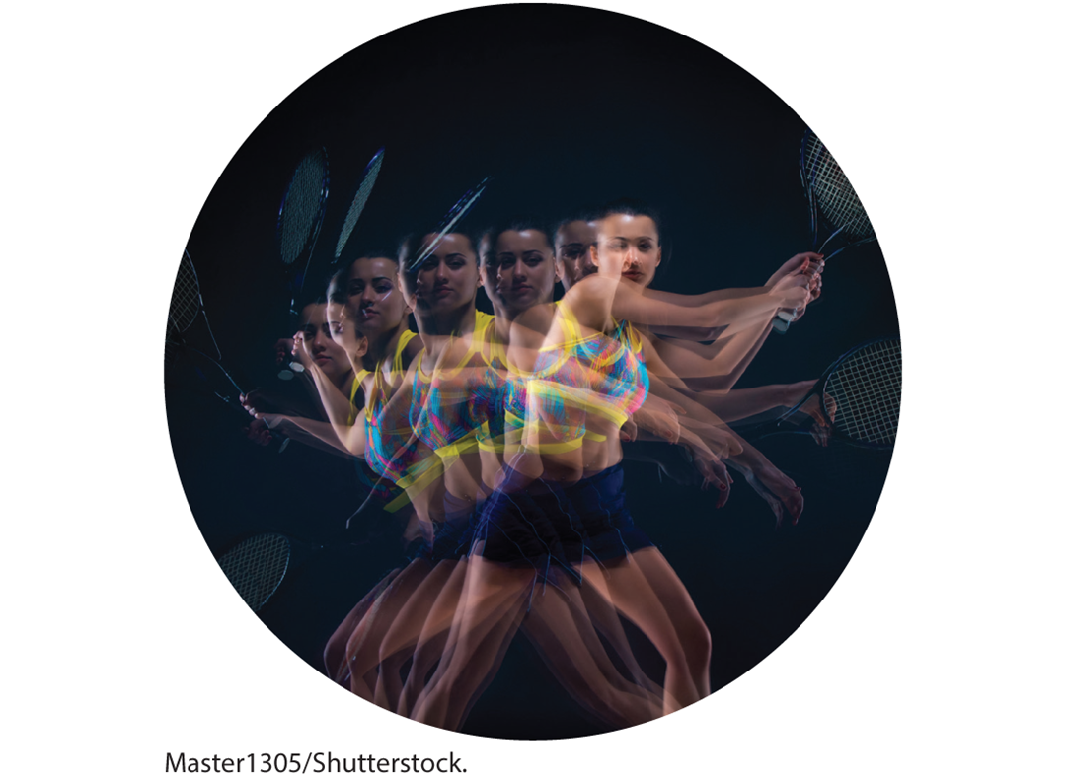
Primary and non-primary Motor Cortices work together to initiate motor plans
Motor plan: set of muscle commands established before the action occurs.
Evidence for motor plans: say “Peter Piper Picked a Peck of Pickled Peppers”

Slide 5
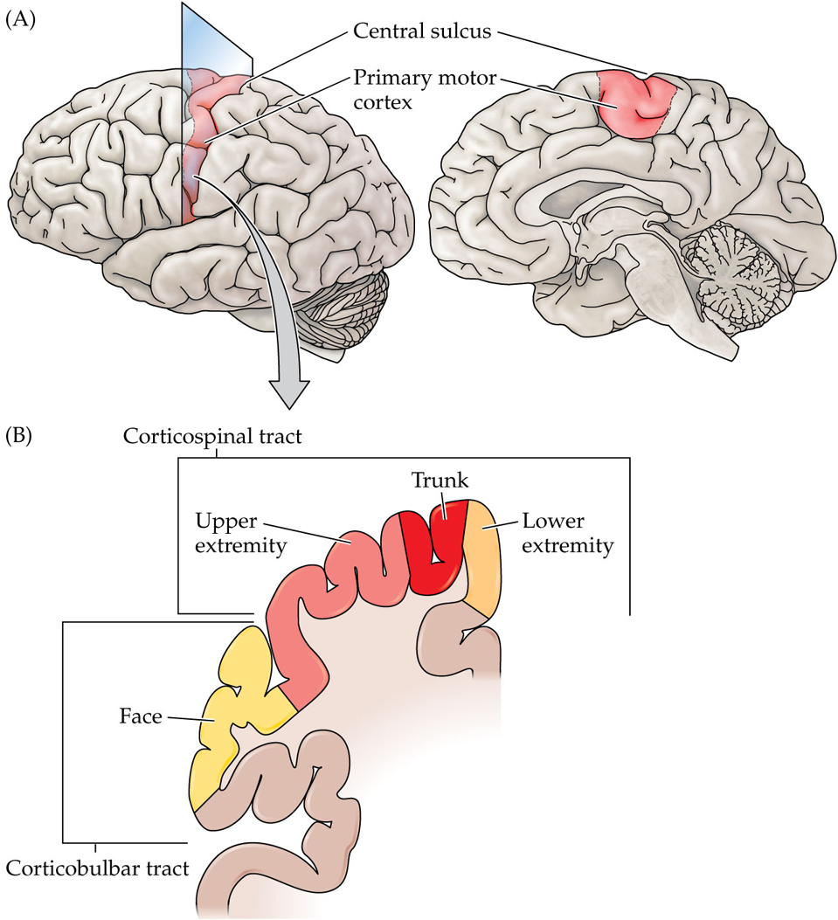
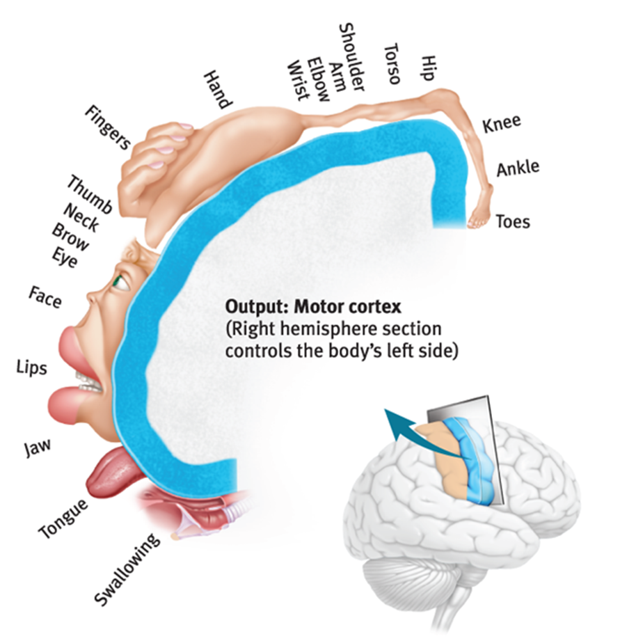
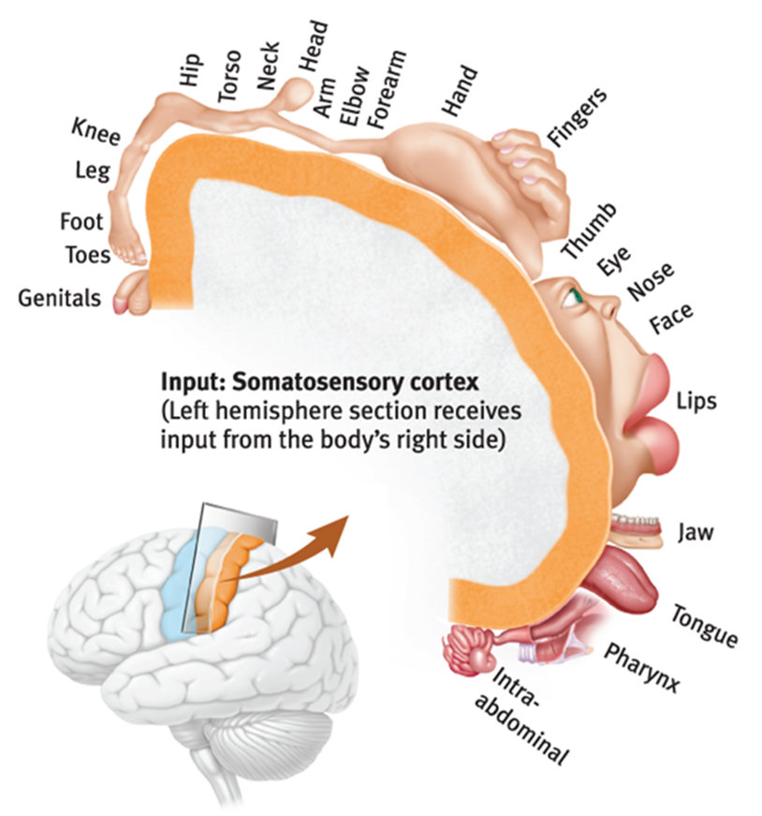
Organization of primary motor cortex
Similar, but not identical to somatosensory cortex.

Slide 6
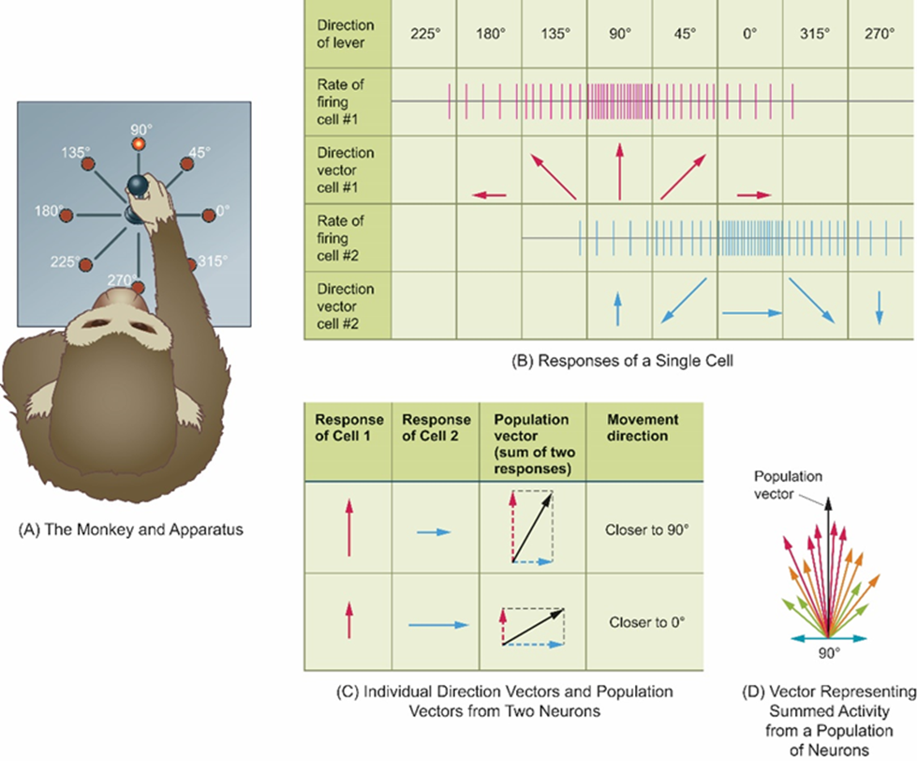
UMNs of primary motor cortex
Betz and Non-betz cells
Firing rate of UMNs in primary motor cortex primarily reflects movements rather than activation of specific muscles.
Also, stimulation of the motor cortex elicits multiple effects.
  Stimulates or inhibits various muscles.
This all suggests UMNs control movement more than muscles.

Slide 7
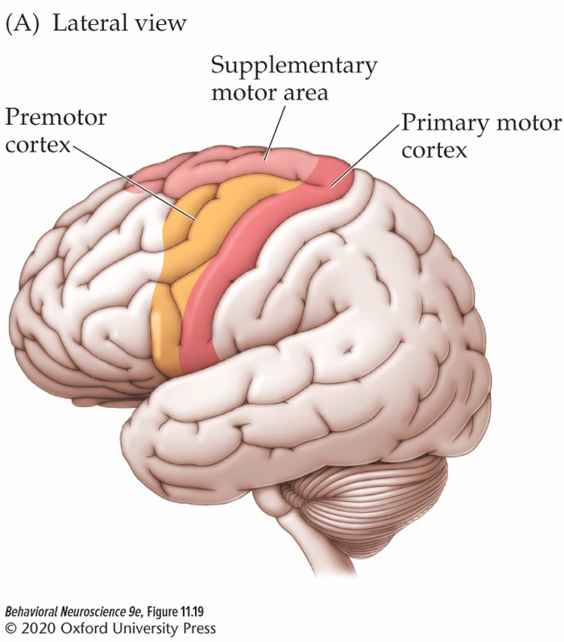
Premotor Cortex
Premotor cortex: directs movement in response to external cues.
Influences motor function directly and indirectly.
  Indirectly via reciprocal connections with the motor cortex
  Directly via axons projecting via the corticospinal and corticobulbar tracts.

Slide 8
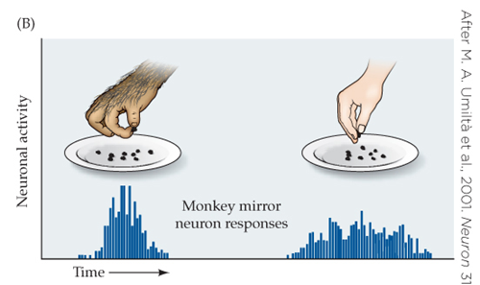
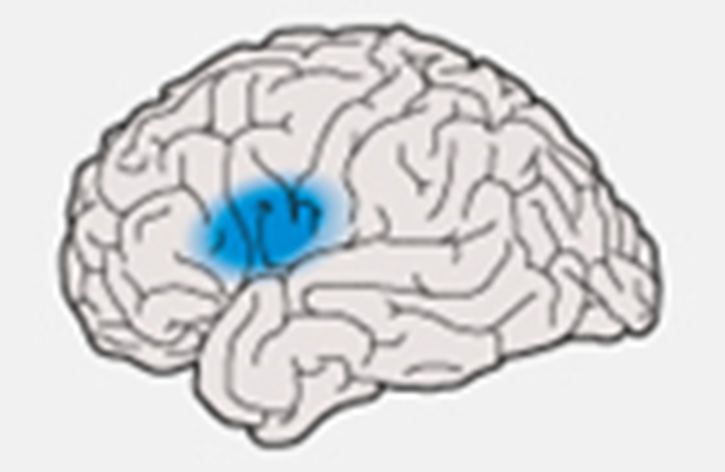
Subdivisions of Premotor Cortex
Lateral: timing of movements (closed-loop)
  Ventrolateral: mirroring observed movements
    Mirror neurons: neurons active both when an individual makes a movement and when the individual sees another individual make the same movement.
      Important for observational learning and possibly theory of mind and empathy.
  Left rostral lateral: speech production
Medial: initiating movements specified by internal rather than external cues (open-loop)
  Frontal eye fields: directing visual gaze

Slide 9
The Supplementary Motor Area
Supplementary motor area (SMA): important for planning movements that are internally generated.
More to be learned…

Slide 10
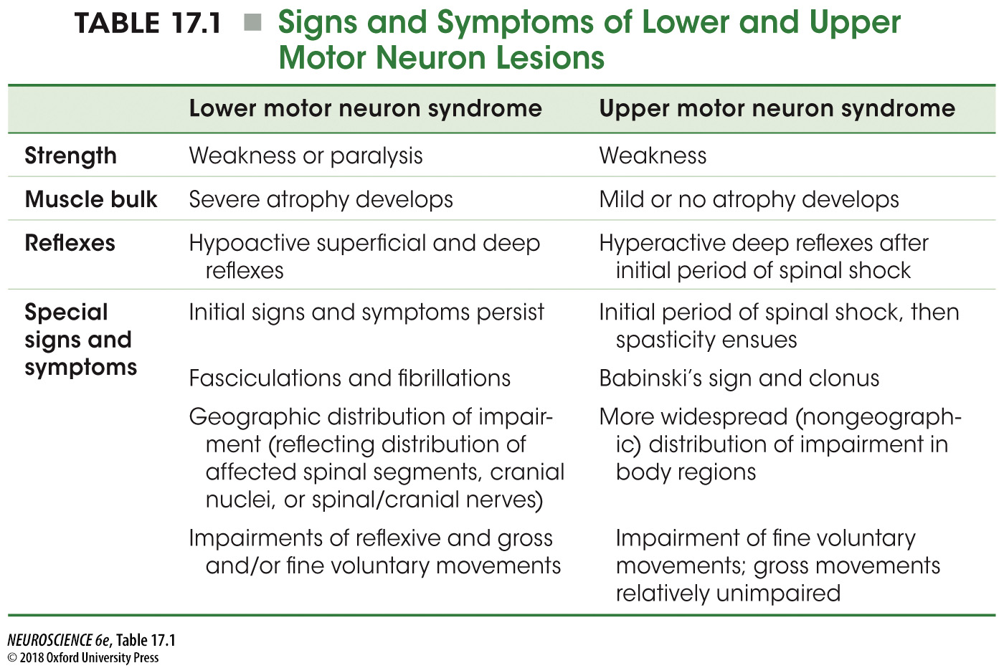

Slide 11
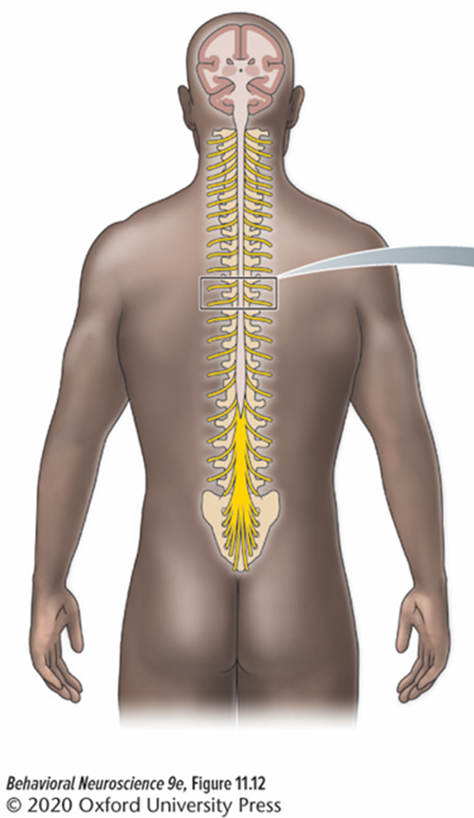
Spinal Shock
An immediate, but short-lived period of flaccid paralysis that accompanies damage to UMNs
Likely stems from decreased activity of spinal circuits suddenly deprived of input from the motor cortex and brainstem.
  After a few days, these circuits regain much of their function.
Typically precedes spastic paralysis

Slide 12
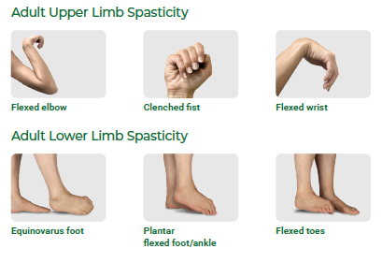
Spastic Paralysis
Characterized by hypertonia, hyperactive stretch reflexes, and clonus.
Damage to UMNs rostral to the vestibular nuclei but caudal to the red nucleus results in severe hypertonia, called decerebrate rigidity.

Slide 13
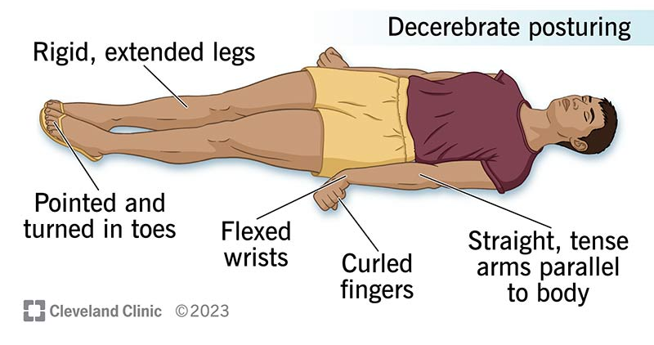
Decerebrate Rigidity
Arms stiffly extended
Jaw clenched
Neck retracted
Wrists flexed outwards
Fingers curled
Legs stiffly extended
Plantar flexion of the feet
Presumably, the increased tone of supra-spinal damage is due to input from the reticular formation and vestibular nuclei that remains.

Slide 14
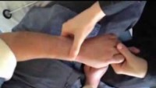
Clonus
oscillatory contractions and relaxations of muscles in response to muscle stretching
https://youtu.be/aZCGF-nJEKU

Slide 15
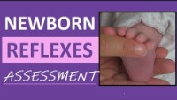
Normal Babinski Reflex in Infants
https://www.youtube.com/watch?v=rHYk1sYsge0

Slide 16
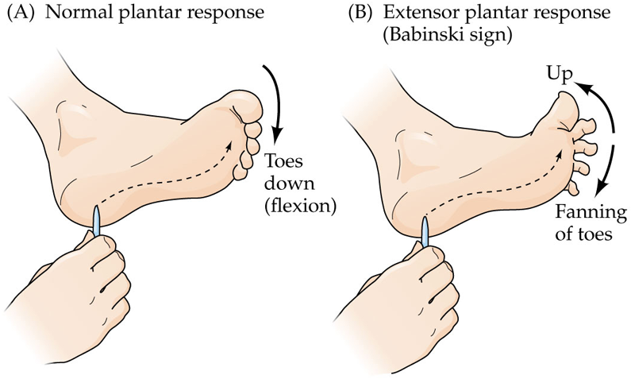

Slide 18
Common Causes of Motor Neuron Syndromes
Localized CNS lesions can cause motor neuron syndromes:
  Post-polio syndrome
  Spinal cord injury or traumatic brain injury
  Strokes
  Multiple sclerosis
  Atypical parkinsonism
  Cerebral palsy
Amyotrophic lateral sclerosis (ALS): degeneration of LMNs and UMNs
Primary lateral sclerosis (PLS): only affects UMNs (progressive from legs to head); likely a variant of ALS

